Slide 1
LAW OF EVIDENCE
TOPIC:
WITNESSES- COMPETENCE AND EXAMINATION (UNIT V)
© Sumiti Ahuja, Assistant Professor, Law Centre-II, University of Delhi

Slide 2
Sub-Topics
(a) Competence
  (i) Child Witness – section 118
  (ii) Dumb Witness – section 119
  (iii) Hostile Witness – section 154
(b) Examination
  (i) Chief examination
  (ii) Cross-examination
  (iii) Re-examination
  Relevant Provisions: sections 137-139, 155 of the Indian Evidence Act, 1872.

Slide 3
"Witnesses are the eyes and ears of justice”.
-bentham
Part I: General Understanding of Witness and Witness Testimony

Slide 4
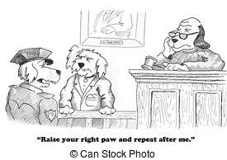
WITNESS
Who is a witness?
Who can be a witness?
What are the various types of witnesses?
Is it necessary to take oath before giving testimony in court?
What is the importance of witness testimony in court?

Slide 5
Who is a witness?
In common legal parlance, any person appearing before a court or tribunal to provide evidence or testimony is called a witness for or against any person involved in it.
According to Black’s Law Dictionary ,“Witness is one who sees, knows or vouches for something or one who gives testimony, under oath or affirmation in person or by oral or written deposition”.
Witnesses play an important role in the criminal justice system of any country.
Notes:
Black's Law Dictionary (2nd edition) defines witness as a person who has knowledge of an event. Person called to court to testify and give evidence.

Slide 6
As a general rule of evidence, witness must only state the facts which he has seen, heard or perceived and his personal opinion or belief holds no relevance in court of law. It has been observed that, if a witness is allowed to state his opinion, it would amount to delegation of judicial function. [Mubarak Ali Ahmed v. State of Bombay, AIR 1957 SC 857]
Sections 45-51 of the Indian Evidence Act, 1872, lay down the exceptions to this rule.

Slide 7
Who can be a witness?
You may be asked to be a witness if you:
  are a victim of crime
  know something about a particular crime (e.g., you saw it taking place)
  have expert knowledge of a subject (called an 'expert witness’)
  know one of the persons involved in the case (called a 'character witness')
If you give a witness statement to the police, it may be some time before you know if you'll need to go to court. This is because legal cases can take a long time to prepare. If the case does go to court and your evidence is needed, you will be contacted.
Notes:
Character Witness: A person who testifies in court on behalf of another as to that person's positive character traits and the person's reputation in the community. Such testimony is often offered when the person's honesty or morality is an issue, as in some criminal cases and in civil cases involving accusations of fraud.
Source: https://www.law.cornell.edu/wex/character_witness

Slide 8
Indian Law on who is competent to be a witness is given under Section 118 of the Indian Evidence Act, 1872. The same is read as follows:
  “Who may testify- All persons shall be competent to testify unless the Court considers that they are prevented from understanding the questions put to them, or from giving rational answers to those questions, by tender years, extreme old age, disease, whether of body or mind, or any other cause of the same kind. Explanation— A lunatic is not incompetent to testify, unless he is prevented by his lunacy from understanding the questions put to him and giving rational answers to them.”
Notes:
As per Section 118 of the Evidence Act, any person is competent to be a witness unless the Court thinks that he cannot answer the questions being put to him.

Slide 9
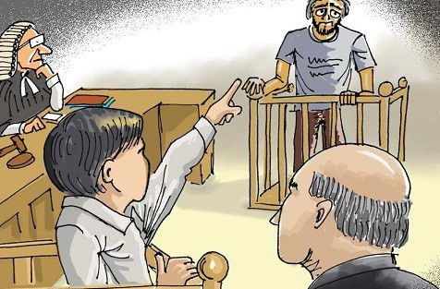
CHILD WITNESS
According to section 118 of Indian Evidence Act, Child witnesses are competent witnesses and stand at the same footing as lunatic, old age, ill person’s evidence provided all of them have the rational understanding of questions put to them and being able to answer them rationally.
Do children make reliable eyewitnesses?
[https://www.youtube.com/watch?v=uqhNQ2iV0OQ]

Slide 10
Child witness (contd.)
Child witness is witness below 18 years of age.
Sole test for checking competency of a child witness is his intellectual capacity to answer questions with rationality.
Supreme Court has held that just because evidence is provided by child it can’t be subjected to rejection. However, Court needs to be extremely cautious when recording evidence provided by child.
On one hand, its easy to tutor and mold a child but at the same time, when a child experiences certain events having huge impact on them, they tend to remember the same even after interval of time.

Slide 11
Dumb witness
Witness unable to communicate verbally is dumb witness.
Section 119 of the Indian Evidence Act provides: “A witness who is unable to speak may give his evidence in any other manner in which he can make it intelligible, as by writing or by signs; but such writing must be written and the signs made in open Court. Evidence so given shall be deemed to be oral evidence:
Provided that if the witness is unable to communicate verbally, the Court shall take the assistance of an interpreter or a special educator in recording the statement, and such statement shall be video graphed.”

Slide 12
Dumb witness (contd.)
When a deaf and dumb person is examined in the Court, the Court has to exercise due caution and take care to ascertain before he is examined that he possesses the requisite amount of intelligence and that he understands the nature of oath. On being satisfied, the witness may be administered oath by appropriate means and that with assistance of interpreter. However in case a person can read and write it is most desirable to adopt that method being more satisfactory than any sign language. Law requires that there must be a record of signs and not the interpretation of signs.
[State of Rajasthan v. Darshan Singh (2012) 5 SCC 789]

Slide 13
A party cross-examining a deaf and dumb witness like any other witness is required to act within the bounds of law and cannot be permitted to cross-examine the witness all and sundry on irrelevant questions.
It is the duty of a Judge to control the cross-examination to prevent any abuse and to protect a witness from being unfairly dealt with.
When a deaf and dumb witness is under cross-examination, the Court is required to take due care of the fact that vocabulary of such a person is limited as he or she speaks through sign language and it may not be possible for that witness to answer, or in detail explain every answer by sign language. This disability of a limited vocabulary of sign language does not affect either the competence or the credibility of such witness. The Court is required to exercise control over the cross-examination keeping in view the ability of the witness to answer the questions.
[Chander Singh v. State, 2016 SCC OnLine Del 3574]

Slide 14
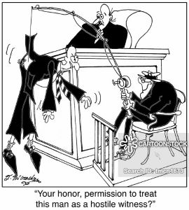
Hostile witness
Hostile witness is one who's provided an eyewitness account of a criminal event or other information to help prosecution build a case, but has later turned in court, giving a different version of events or contradictory information.
Hostility is one form of perjury.

Slide 15
Hostile witness is a witness who testifies for the opposing party or a witness who offers adverse testimony to the calling party during direct examination. ' The term "hostile" witness means adverse or unfavorable witness. Black’s law dictionary define hostile witness as “A witness who is biased against the examining party or who is unwilling to testify”.
Person cannot be declared as hostile solely on the basis that his evidence is favourable for the opponent party.
In Bhajju v. State of M.P. (2012), the SC observed: “when a witness deposes contrary to the stand of the prosecution and his own statement recorded under Section 161 of the Cr.P.C., the prosecutor, with the permission of the Court, can pray to the Court for declaring that witness hostile and for granting leave to cross-examine the said witness.”

Slide 16
Framers of IEA, 1872, deliberately avoided defining or using the terms hostile/adverse/unfavourable witness as it had resulted in conflicting opinions and difficulty in England.
Section 154, IEA, provides: “Question by party to his own witness– (1) The Court may, in its discretion, permit the person who calls a witness to put any question to him which might be put in cross-examination by the adverse party; (2) Nothing in this section shall dis entitle the person so permitted under subsection (1) to rely on any part of the evidence of such witness.”

Slide 17
Section 155 of the IEA, provides for: “Impeaching credit of witness-- The credit of a witness may be impeached in the following ways by the adverse party, or with the consent of the Court, by the party who calls him—
(1) By the evidence of persons who testify that they, from their knowledge of the witness believe him to be unworthy of credit;
(2) By proof that the witness has been bribed, or has accepted the offer of a bribe, or has received any other corrupt inducement to give his evidence;
(3)By proof of former statements inconsistent with any part of his evidence which is liable to be contradicted.”

Slide 18
In Attar Singh v. State of Maharashtra (2013) 11 SCC 719 it was held that, a court cannot preclude the statement of a hostile witness in its entirety and can be relied upon by the court partly if some of its portions rouses confidence. Further, if any other evidence is corroborated by the statement of a hostile witness then there is no legal obligation to pronounce conviction.

Slide 19
Consequences of witnesses turning hostile
When a person produces evidence which he knows or believes to be false, the provisions of the IPC can be set in motion.
Section 191, IPC, provides: “Whoever, being legally bound by an oath or by an express provision of law to state the truth, or being bound by law to make a declaration upon any subject, makes any statement which is false, and which he either knows or believes to be false or does not believe to be true, is said to give false evidence.
Such a statement could be verbal or through any other medium and additionally, must be of the nature of being admissible due to its relevancy.
Punishment has been laid down under section 193, IPC.

Slide 20
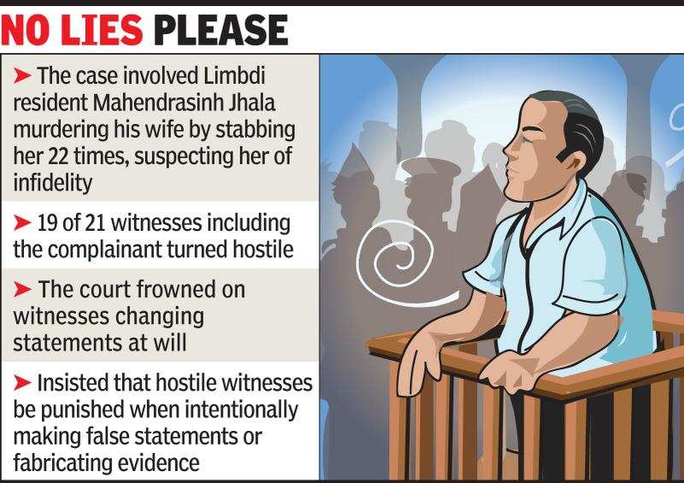
Notes:
In an unprecedented case, the Gujarat High Court in February 2019 ordered a criminal trial against 19 witnesses, for perjury, in connection with a murder trial. Barring two, all the witnesses turned hostile, including panch witnesses and even the complainant. The complainant even denied having filed any such complaint.
Trial for perjury is a rare occurrence in courts. However, the Supreme Court of India in 2006, punished Zaheera Shaikh with three months imprisonment. She was prime witness in Best Bakery case of 2002.
[Source: http://timesofindia.indiatimes.com/articleshow/68225834.cms?utm_source=contentofinterest&utm_medium=text&utm_campaign=cppst]

Slide 21
Primary reasons to turn hostile
Monetary Cause
Unjust delays & adjournments in cases
Threats by the real accused

Slide 22
Threats by the accused, is one of the most common reason for witness turning hostile as they find it better to retract or alter their statements, than endangering theirs or their family members lives.
One of the classic examples of this is Jessica Lal murder case wherein the real culprit was son of a powerful Minister.
Not that no steps have been taken till date, we have Witness Protection Scheme, 2018 [https://pib.gov.in/PressReleaseIframePage.aspx?PRID=1578108]. But still its at a very nascent stage posing certain challenges mainly financial and logistical.
Notes:
Additional Reading has been provided with this presentation for students interested in knowing more about Witness Protection Scheme, 2018.

Slide 23
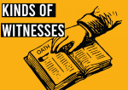
What are the various types of witnesses?
Eye Witness
Expert Witness
Character Witness
Child Witness
Hostile Witness
Interested Witness
Material Witness
Chance Witness
Accomplice Witness
Notes:
Chance Witness: If by coincidence or chance a person happens to be at the place of occurrence at the time its taking place, is called a chance witness.
Interested Witness: One who is interested in securing conviction of a person out of vengeance or enmity or, a witness in a trial who has a personal interest in the outcome of the matter at hand.
Accomplice Witness: Witness to a crime who either as principal, accomplice or accessory, was connected with the crime by unlawful act or omission on his or her part, either before, at the time or after commission of the offence.
Material Witness: Crucial witness in a case; a witness material in relation to the subject matter of the litigation and does not mean material in relation to parties.

Slide 24
Other relevant provisions
Section 125, IEA
“No Magistrate or police officer shall be compelled to say whence he got any information as to the commission of any offence…”
Section 134, IEA
“No particular number of witnesses shall in any case be required for the proof of any fact.”
Notes:
ALSO READ
Section 132, IEA: “Witness not excused from answering on ground that answer will criminate.-A witness shall not be excused from answering any question as to any matter relevant to the matter in issue in any suit or in any civil or criminal proceeding, upon the ground that the answer to such question will criminate, or may tend directly or indirectly to criminate, such witness, or that it will expose, or tend directly or indirectly to expose, such witness to a penalty or forfeiture of any kind:
Provided that no such answer, which a witness shall be compelled to give, shall subject him to any arrest or prosecution, or be proved against him in any criminal proceeding, except a prosecution for giving false evidence by such answer.”

Slide 25
Is it necessary to take oath before giving testimony in court?
As a general rule, yes it is.
Under the 1969 Oaths Act, witnesses can swear by a universal god without referring in any way to any particular religious denomination.
  “I do swear in the name of God/solemnly affirm that what I shall state shall be the truth, the whole truth and nothing but the truth,” was the format prescribed.
  [Read: https://www.telegraphindia.com/india/a-myth-about-gita-in-court-witnesses-in-india-no-longer-take-oath-by-holy-book/cid/460444].

Slide 26
What is the importance of witness testimony in court?
The below mentioned quotes satisfactorily answer the above asked question.
“Discovering witnesses is just as important as catching criminals.”
- Simon Wiesenthal
“A trial without witnesses, when it involves a criminal accusation, a criminal matter, is not a true trial.”
-Bill McCollum

Slide 27
Lawyer Breaks Down 30 Courtroom Scenes From Film & TV: https://www.youtube.com/watch?v=we6qm0zXMYU&list=WL&index=3&t=0s
Enjoy Watching this video till you receive the Part-II of Presentation on Witnesses dealing with Examination of Witnesses.

Slide 28
“Justice will overtake fabricators of lies and false witnesses.”
- heraclitus
Part II: Examination of Witnesses under the Indian Evidence Act, 1872

Slide 29
Diagram on right side depicts order of examination of witness ⇒⇒⇒⇒
Examination-in-chief
Cross-examination
Re-examination
Examination of witnesses plays an important role in the presentation of the evidence in a court of law irrespective of the civil or criminal case and admissibility of evidence is also an important aspect which has to be decided by the judges only.

Slide 30
Sections 137-139, iea
“Section137. Examination-in-chief, Cross-examination and Re-examination
  Examination-in-chief: The examination of witness by the party who calls him shall be called his examination-in-chief.
  Cross-examination: The examination of a witness by the adverse party shall be called his cross-examination.
  Re-examination: The examination of a witness, subsequent to the cross-examination by the party who called him, shall be called his re-examination.”

Slide 31
Sections 137-139, iea
“Section138. Order of Examinations:
  Witnesses shall be first examined-in chief, then (if the adverse party so desires) cross-examined, then (if the party calling him so desires) re-examined.
  The examination and cross-examination must relate to relevant facts but the cross-examination need not be confined to the facts to which the witness testified on his examination-in-chief.
  Direction of re-examination. The re-examination shall be directed to the explanation of matters referred to in cross-examination; and, if new matter is, by permission of the Court, introduced in re-examination, the adverse party may further cross-examine upon that matter.”
Notes:
This section is very important to understand the order and basic procedure followed in examination of witnesses.

Slide 32
Sections 137-139, iea
“Section139. Cross-examination of person called to produce a document
  A person summoned to produce a document does not become a witness by the mere fact that he produces it and cannot be cross-examined unless and until he is called as a witness.

Slide 33
Examination-in-chief
Object is to place the witness’s story before the court, and is conducted by his own counsel.
It is the duty of counsel to bring out clearly and in proper chronological order every relevant fact in support of his client’s case to which the witness can depose.
Timid witness must be encouraged; talkative witness must be repressed; the witness who is too strong a partisan (opinionated/prejudiced) must be kept in check.
Counsel is not supposed to suggest to the witness what he is to say.
General questions are put up to the witness. Leading questions should not be asked.

Slide 34
Examination-in-chief/Direct Examination
Do’s
Don’ts
Identify what information each witness can contribute to case.
Don’t use leading questions.
Prepare series of questions to obtain information from witness you will examine.
Listen to the answers to your questions.
Don’t ask opinion seeking questions from witness unless witness is expert (S.45, IEA).
Don’t use questions that require witness to draw conclusion or to speculate.
Notes:
Source: http://www.coloradohighschoolmocktrial.com/portals/15/repository/Teaching%20Mock%20Trial%20Guide%2012-6-12.pdf

Slide 35
Cross-examination
In words of Prof. Wigmore it is “the greatest legal engine ever invented for the discovery of truth”.
Cross-examination has also been referred as an acid test for truthfulness of the statement made by a witness.
It need not be confined to facts to which witness testified in his examination-in-chief, but it can be examined as to the whole of the case.
Every witness need not be cross-examined by the opponent counsel. It all depends upon the nature of deposition and whether the opponent counsel disputes the facts sought to be established thereby.

Slide 36
Cross-examination (contd.)
The effect of non cross-examination is that the statement of witness has not been disputed.
The Court generally not interferes with the discretion of counsel while cross-examining a witness (i.e., laying down of time limits), although it may do so when such privilege is being abused and cross is being inordinately lengthy.
A lawyer should use leading questions i.e. “is that correct?” and “isn’t it a fact” etc. at the time of Cross-Examining of the witness because asking leading questions is perhaps the oldest rule of Cross-Examination.

Slide 37
Object of Cross examination
The object is three-fold, namely:
  To destroy or weaken the evidentiary value of witness of the adversary;
  To elicit facts in favor of the cross-examining lawyer’s client from the mouth of the witness of adversary party; and
  To show that the witness is unworthy of belief by impeaching the credit of the said witness.
Questions to be put across in course of cross-examination are to test the witness’s veracity and perhaps to shake his credit by injuring his character.

Slide 38
Cross-Examination
Do’s
Don’ts
Questions must be relevant to the case.
Don’t ask questions that call for a narrative answer.
Ask leading questions only.
Don’t beat a dead horse-once you’ve made your point move on.
Question should be short and clearly framed.
Listen to the answer.
Know the probable answer before you ask it.
Notes:
Source: http://www.coloradohighschoolmocktrial.com/portals/15/repository/Teaching%20Mock%20Trial%20Guide%2012-6-12.pdf

Slide 39
Re-examination
Purpose is to get clarification of some doubts created in cross-examination.
One cannot supplement the examination-in-chief by way of a re-examination and for the first time, start introducing totally new facts, which have no concern with the cross-examination.
It may be done by the parties to remove incompatibility which arises during the examination-in-chief and cross-examination.
Leading questions are not allowed.

Slide 40
Leading questions
(sections 141-143, iea)
“Section 141. Leading Questions.
  Any question suggesting the answer which the person putting it wishes or expects to receive is called a leading question.”
“Section 142. When they must not be asked.
  Leading questions must not, if objected to by the adverse party be asked in an examination-in-chief, or in a re-examination, except with the permission of the Court.
  The Court shall permit leading questions as to matters which are introductory or undisputed, or which have, in its opinion, been already sufficiently proved.”
“Section 143. When they may be asked.
  Leading questions may be asked in cross-examination.”

Slide 41
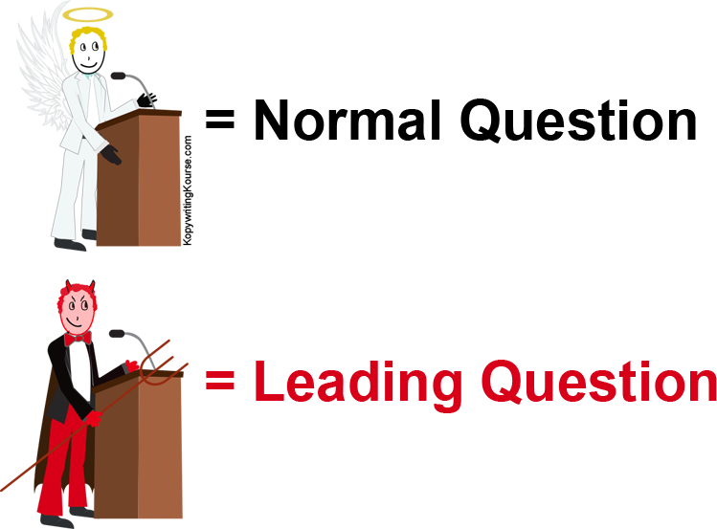
Leading questions
It’s how lawyers may “control” the answers of a witness, or “suggest” a person did something wrong.
Generally, the answers of leading questions are yes or no.

Slide 42
Leading questions examples
Leading questions are only appropriate during cross-examination.
  For example, these are leading questions: “Isn’t it true that she returned from work at 10:30 that night?” and “They work for the same company, right?”
  The proper way to ask questions in a direct examination would be to say something like, “What time did she return from work that night?” or “Which company do they work for?”
Notes:
Source: https://www.nsfamilylaw.ca/sites/default/files/video/selflitigantworkbookdraft9-aug7-links.pdf

Slide 43
Leading questions examples
Isn’t it true Mr. X that you dislike Mr. Y?
Were you not in the building that day?
Mr. X, didn’t you see Z put the money into the briefcase?
Isn’t it true that you left your workplace comparatively early that day?
[Note: Questions which begin with, "What...", "When...", "How... ", "Where... " are, usually, non-leading. Questions which begin with, "Did... ", "Was...", "Were...“ are, usually, leading].

Slide 44
Other relevant provisions from iea
Section 132. Witness not excused from answering on ground that answer will criminate.
Section 140. Witnesses to character.
Section 145. Cross examination as to previous statements in writing.
Section 146. Questions lawful in cross examination.
Section 147. When witness to be compelled to answer.
Section 148. Court to decide when question shall be asked and when witness compelled to answer.

Slide 45
you may watch
https://www.youtube.com/watch?v=yyv20R-k3aY (Courtroom scene from the movie Legally Blonde)
https://www.youtube.com/watch?v=kY_i62FHcd8 (Mock Trial: Direct Examination of Witness)
https://www.youtube.com/watch?v=IX_exPe0Sc8 (Mock Trial: Cross-examination?
https://www.youtube.com/watch?v=_lWx_HSjQV4 (Cross-examination scene from Jolly LL.B. 2)
https://www.youtube.com/watch?v=UOLix3zrnbg (Clip from A Few Good Men)
https://www.youtube.com/watch?v=CUrSxy5K0mI (The Devil’s Advocate Clip)

Slide 46
You may suggest more such videos on examination and cross-examination, if you are aware of any
THANK YOU, HAPPY READING AND WATCHING

